Slide 1
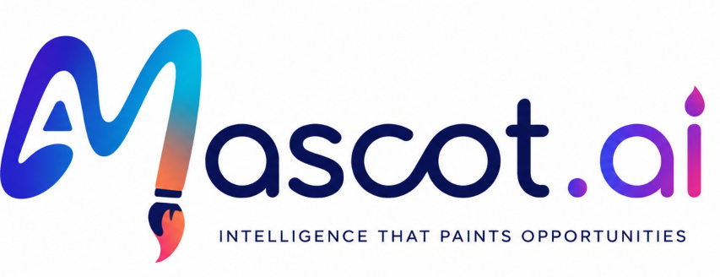
MArket SCanning Tool
AI-powered market scanning & lead discovery agent for the paint industry

Slide 2




The Problem
Paint sales reps must spot project-driven demand fast — but today that means digging manually through financials, tenders, news and social signals, using tools that were never built for the paint industry.
Manual, Multi-Source Research
Generic, Industry-Agnostic Tools
No Visibility into Client Pipeline
Same Pitch for Every Client
Hours lost per week hunting for company & project signals across news, tenders and filings
Clay, ZoomInfo & CRMs give broad data, not paint-specific demand signals
Reps miss early construction, OEM and industrial signals competitors act on first
Without financial & project context, product recommendations aren’t tailored

Slide 3



Our Solution
“For sales reps who want to identify and qualify the right clients before every meeting — MASCoT AI is a paint-industry-specific market scanning agent that automates prospect research, financial analysis, and personalized outreach.”
What makes it different
Paint-Specific Signals
Agentic Automation
Verified, Low-Hallucination
Construction permits, OEM schedules & anti-corrosion regulation updates — not generic B2B data
Web-scanning agent turns scattered signals into one summarized report per prospect
Fed on an authentic paint sales lifecycle for maximum relevance and minimum bias

Slide 4



Development Approach
A design-thinking process, from user empathy to a testable prototype
EMPATHIZE
DEFINE
PROTOTYPE & TEST
Who & why are we building this?
What are we building?
How are we building it?
B2B sales reps, sales managers, BD and marketing teams at paint companies who lose hours a week to manual, multi-source research.
An AI agent that scans the market, aggregates financial, news and social signals, and finds potential leads for the client.
An AI agent that performs market scanning, report generation and financial-detail analysis — validated through Regression and A/B testing.

Slide 5



Key Features
MVP feature set, prioritized with the MoSCoW framework
Industry-Level Market Scanning
Automated Insight Reports
Product-to-Lead matching engine
Scans projects, tenders, news & social signals for paint demand
One summarized, ready-to-use company report per prospect
Market identification with product - consumer mapping with the users prompt
Feature Prioritisation (MoSCoW)
Must Have
Should Have
Could Have
Industry-level market scanning for paint leads
Automated company insights report per prospect
Product-to-Lead matching engine
Client financial & order-history reports
Cold-email automation to leads
Workflow automation incl. scheduling

Slide 6
AI Agent Architecture
1
2
3
Get Product Info from Sales Representatives
Identify Suitable Industries for these products
Get List of Companies from these industries
Phase 1
Sales Strategy Agent - Phase 2

Slide 7
AI Agent Architecture
1
2
3
4
5
Company Agent
Financial Agent
News Agent
Social Media Agent
Procurement Agent
Sources: DuckDuckGo search: LinkedIn, Wikipedia, Volza.
Extracts description, projects, key decision makers.
Sources: yFinance, NSE/BSE, SEC filings.
Extracts revenue, profit, capex, and investments.
Sources: Google News RSS, Reuters, Economic Times.
Extracts expansion,
acquisitions, partnerships.
Sources: Customer reviews, Twitter/X sentiment, PR mentions.
Generates sentiment score.
Sources: RERA, GeM, government tender portals.
Extracts procurement patterns, past contracts.
Sales Strategy Agent
Receives all 5 context windows.
Uses a structured system prompt to generate a full JSON: pitch strategy, key selling points, signals, financial summary, and decision makers.

Slide 8
GTM Strategy (Segmentation, Targeting & Positioning)
...and the 7M’s that guide how we take it to market
Segmentation
The 7M’s
By industry (Construction, Industrial, Automotive OEM, Designers/EPC), company size, and needs/behaviour
Mission
Create awareness first, then improve lead generation
Market
Paint manufacturers & distributors across Indian cities
Targeting
Media
LinkedIn, Google, blogs, social media ads
Medium/large B2B paint manufacturers in India with dedicated sales teams — highest willingness to pay
Message
“Never miss your next big paint sales opportunity”
Money
~10% of the product budget to marketing
Positioning
Moment
Post-Monsoon & Festive Quarter (Sept–Jan) peak demand
The only AI sales-intelligence platform purpose-built for paint, with verified industry-specific signals
Metrics
CTR, conversion, ARPU, churn rate

Slide 9
Market Opportunity & Impact
$303M
$258.6M
$13.05M
TAM
SAM ( 85% of TAM )
SOM ( 5% of SAM )
Global paint-industry sales-software spend
Software spend from Industrial & commercial paints segment
India-specific obtainable market from Industrial & commercial segments
Bottom-Up Revenue Forecast
Company Size | No. of Companies | Avg. Employees | Sales Team % | Sales People | Price/Employee ($/yr) | Revenue Forecast ($)
High | 10 | 5,000 | 15.4% | 7,700 | 120 | 924,000
Medium | 1,100 | 800 | 12.4% | 109,120 | 80 | 8,729,600
Small | 2,100 | 200 | 8.0% | 33,600 | 50 | 1,680,000
Total |  |  |  |  |  | 11,333,600
Sales people = Company count × Avg. employees × Sales-team % · Revenue = Sales people × Price per employee/year (for Subscription model) followed by Pay as you Go
Impact
Reduction in manual effort and time to identify new prospective clients.
Improve customer conversion rate
Potential for growth in cross sales

Slide 10
Thank you

